Slide 1
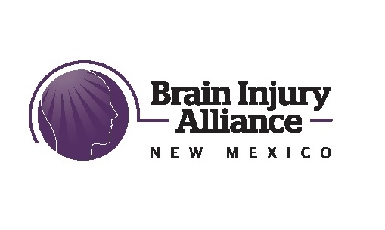
Overview to Identification & Management of Brain Injury, Including in Survivors of Domestic Violence, for Healthcare Providers
W. Austin Davis, MD, Miryam Miller, MD, Mark Pedrotty, PhD, & Gail Starr, RN
June, 2023
DVBI Care Network Project

Slide 2
Thank You for this Opportunity
Brain injury (BI), whether traumatic brain injury (TBI) or acquired brain injury (ABI), is very prevalent in NM and affects all groups.
Accommodations to the communication and environmental demands with first responders & health care providers are essential for people living with BI to get the best possible care per the Americans with Disabilities Act (ADA).
Brain injury is an epidemic in domestic violence and considered to be a silent epidemic generally.
In 2020, the Government Accountability Office released a report warning that the lack of data-gathering on traumatic brain injuries in abused women makes it impossible to confront the crisis in a meaningful way.
Training on identifying brain injury in cases of domestic violence at the Tempe Police Department’s domestic-violence unit, “taught everyone, from beat cops to detectives, that women displaying inconsistency, hostility and bewilderment aren’t necessarily being uncooperative. It could be because they’re actually injured, that it’s not a visible injury,” an officer said. “You have to realize that potentially inside their head, they’re trying to tell you a story, but it’s just not coming out.”
“Individuals with brain injury may have symptoms that make it difficult for them to follow directions or communicate clearly. Too often, these individuals are mistaken for being drunk or purposefully aggressive, which leads to misunderstandings with law enforcement. It is imperative that first responders (and health care providers) throughout the country receive specialized training to help them understand the complexities involved with brain injury,” Susan Connor, President/CEO, Brain Injury Association of America

Slide 3
Disclosures
This training is made possible by funding from the New Mexico Brain Injury Advisory Council on the Governor’s Commission on Disability to the Brain Injury Alliance of New Mexico (BIANM).
W. Austin Davis, MD is a Physical Medicine & Rehabilitation doctor (physiatrist) and works at UNMH-HSC and Lovelace.
Miryam Miller, MD is an ED doctor and works at UNMH-HSC
Mark Pedrotty, PhD is a board member of the Brain Injury Alliance of New Mexico (BIANM) is a rehabilitation psychologist in private practice in New Mexico, and is a co-founder of the Integrative Cognitive Rehabilitation Psychotherapy Institute
Gail Starr, RN is a nurse and works at S.A.N.E. in Albuquerque.

Slide 4
Learning Objectives
Describe prevalence, causes (including strangulation) and outcome of brain injury
Describe identification and management of concussion and emergent issues following brain injury
Describe management of medical, psychosocial and cognitive sequelae
Describe DVBI Care Network
Provide a general understanding of the difficult, stressful, and courageous journey of recovery that many people living with brain injury must go through and the importance of empathy and support by health care providers to provide care and instill hope.
Additional training is available on specific topics reviewed here and other related topics. Please call the BIANM for further information on additional training.
Note: The information presented in this training should be updated regularly, at least by June 2025.

Slide 5
Human Brain
Every brain injury is unique.
Parietal Lobe
Integrating sensory information, knowledge of numbers and their relations, visual spatial processing
Frontal Lobe
Occipital Lobe
Planning, doing, evaluating, organizing, inhibiting
Visual processing
Cerebellum
Movement, balance, attention
Temporal Lobe
Language, speech, memory, emotion, facial recognition
Heart rate, blood pressure, alertness breathing, swallowing, digestion
Brain Stem

Slide 6
Who Gets Brain Injuries
Anyone can get a brain injury!
Every 15 seconds someone gets a TBI (Upenn.edu)
Every 40 seconds someone has a stroke
Several groups have more brain injuries than the typical group
Homeless have 50% more TBI and 25% have moderate to severe TBI
Incarcerated have 30% more TBI
3 out of 4 women (75%) have suffered a TBI by their abusive partner, with 50% of them suffering more than one TBI, including strangulation – making it an epidemic in this population
Increased prevalence in behavioral health and substance use groups
Twice as many adults with IDD than without IDD
Elderly are at higher risk due to falls, MVA and if on blood thinner medication (e.g. Plavix, coumadin, & aspirin)
Veterans, including from explosive devices
In NM about 369,319 adults (25%) have had a TBI with loss of consciousness and 59,091 (4%) need services for TBI. (Whiteneck, 2019). About 40% of adults have had a TBI of some sort (Whiteneck et al. 2016)
Important to identify signs and symptoms of brain injury.
Important to quickly get medical care when needed.
Important to NOT BE FOOLED by signs and symptoms that are similar to other conditions when there is a chance that a brain injury occurred.
Important to break the silence, talk about brain injury, ask questions, find out what a person needs, and get/give the help that is needed.
Important to provide hope and compassion.
Important to prevent brain injuries as much as possible, including repeat brain injuries.

Slide 7
How Do People Get Traumatic Brain Injuries and What are Prevention Efforts
Falls
*Infant-Toddlers – walk, climb, drop
Kids –climb, play, sports
Adolescents, sports, play, walk, climb
Adults –walk, play, sports, ladders, climb, work, etc.
*Elderly - walk
Prevention: helmets, safe equipment to play on, law to prevent concussed athletes to play, bathmats, ramps, grab bars, railings, lighting, supervision, law to require children wear helmets, make homes safe to walk in for elderly, education on NEVER SHAKE A BABY!, etc.
Motor Vehicle Accidents (MVA)
Everyone who is around vehicles
Prevention: seatbelt law, car seat law, airbags, speed limits, grooved roadways, lighting, DWI law, driver license, back up cameras, driver assist, Good driver car insurance deduction, etc.
Assaults & Blow to Head
Prevention: sports referees, assault law, legal drinking age, Red Flag law, restraining orders, limits on places guns, alcohol and drugs are allowed, safety gear at worksites, netting at ball parks, etc.
Top 3 causes of TBI in the US are Falls, MVA, and being struck by or against an object (CDC).

Slide 8
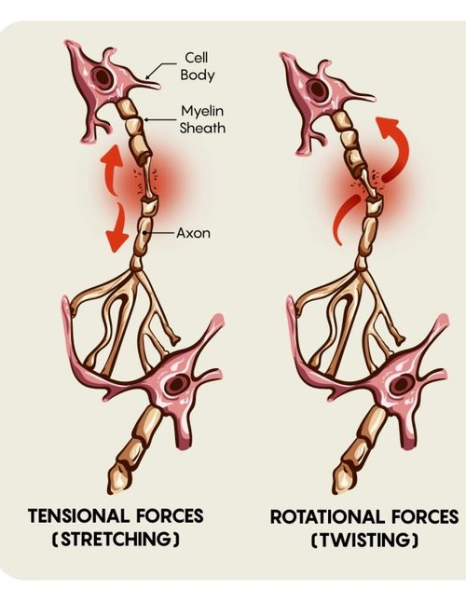
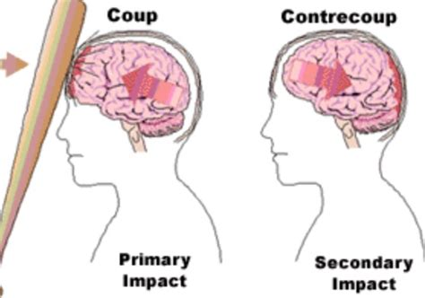
What Causes TBI
Penetrating injury – skull bone fragments, bullets, nails, rods, etc.
Blow to the Head – falls, assaults, etc.
Coup contra Coup
Diffuse Axonal Injury – acceleration and rotational forces from falls, MVA, etc.

Slide 9
How Do People Get Acquired Brain Injuries & What Are Prevention Efforts?
Loss of Oxygen to the brain (hypoxia and anoxia)
Drowning, choking, suffocation, strangulation, cardiac arrest.
Prevention – lifeguards, life vests, Heimlich maneuver, warning labels, recalls, felony law against strangulation, domestic violence shelters, etc.
Toxic Exposure:
chemicals in the air (e.g., carbon monoxide), paint, alcohol, illicit drugs, etc.
Prevention: EPA, OSHA, warning labels, law limiting purchase of paint by children, etc.
Medical conditions:
Stroke, infections, brain tumors, genetic conditions, cancer, surgery, seizures, MS, Parkinson's, Korsakoff, Chronic Traumatic Encephalopathy, Sudden Impact Syndrome, etc.
Prevention: BE FAST, concussion protocols, screens
Electrocution:
Prevention: protective equipment, trip electrical outlets, safety warnings, weather warnings, etc.

Slide 10
How a Person Could Behave After a Brain Injury, Including from Strangulation
Disorientation, confusion, disorganization, poor balance, poor speech, sensitivity to light and sound, and disinhibition can occur. This can result in looking intoxicated and becoming belligerent, combative, and noncompliant with others, including healthcare providers, law enforcement and other first responders .
Fear and shock related to the injury can cause further problems when interacting with law enforcement, first responders, health care providers, family, and other groups.
Over time, continued symptoms can result in confusion, irritability, concern and fear that there is something wrong or they are going crazy.
Education on what is actually happening to them can bring some relief.
This is great bodily harm, as it is a permanent harm, that varies in severity and needs to be properly treated.

Slide 11
Severity of Brain Injury**
 | Concussion/Mild | Moderate | Severe | Fatal
GCS* | 13 or more | 9-12 | 3-8
LOC* | < 30 minutes | 30 min – 24 hours | >24 hours
PTA* | <24 hours | 24 hours – 7 days | > 7 days
ADL* | Mild | Moderate | Severe
Duration | Few hours to a lifetime | Long-term or lifetime | Lifetime
Diagnoses Medical/ Cognitive / Personality | Specific Injury/ Mild or Major Neurocognitive / Personality Change | Specific Injury/ Mild or Major Neurocognitive/ Personality Change | Specific Injury/ Major Neurocognitive/ Personality Change
*GCS= Glasgow Coma Scale; LOC = Loss of Consciousness; PTA=Posttraumatic Amnesia; ADL= Activities of Daily Living
**Repeated Brain Injuries Can Result in Longer Recovery Time and Worse Outcome

Slide 12
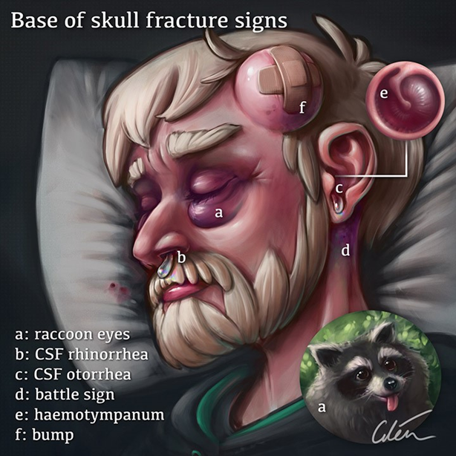
Symptoms of Brain Injury Requiring ER Care
One pupil larger than the other.
Drowsiness or inability to wake up.
A headache that gets worse and does not go away.
Slurred speech, weakness, numbness, or decreased coordination.
Repeated vomiting or nausea, convulsions or seizures (shaking or twitching).
Unusual behavior, increased confusion, restlessness, or agitation.
Loss of consciousness (passed out/knocked out). Even a brief loss of consciousness should be taken seriously.
For Toddlers and Infants, include
Will not stop crying and cannot be consoled
Will not nurse or eat
BE FAST for Stroke
Fall from 8 feet or
Fall down 5 stairs
Signs of Skull Fracture
Medical Illustration by Dr.Ciléin Kearns (Artibiotics) https://artibiotics.com/

Slide 13
Signs of Increased IntraCranialPressure (ICP)
Headache
Vomiting
Vision issues: blurred, double, photophobia
Altered mental state – alertness confusion, orientation, and PTA.
Changes in behavior
Shallow breathing
High blood pressure
Cushing triad: hypertension, bradycardia, and irregular respiration are signs of pending herniation
Weakness or problems with moving or talking
Note: ICP can be easily mistaken for other issues, such as intoxication, stroke, infection, or post-ictal state

Slide 14
Observation Period if No ER Care Indicated
If immediate imaging or ER care is not indicated
Observe for 6 hours after injury
At home vs in ED: send to ED if HAVE RISK FACTORS
Continued observation for first 24-48 hours for serious signs – red flag
Go to ER for imaging if person develops warning signs:
Severe or worsening headache
Seizures
Altered mental status
Focal neurological symptoms
Signs of increased ICP

Slide 15
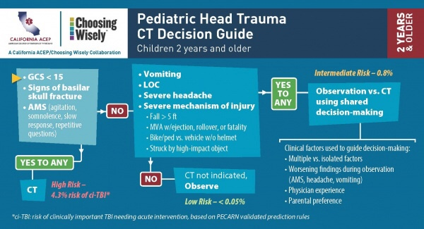
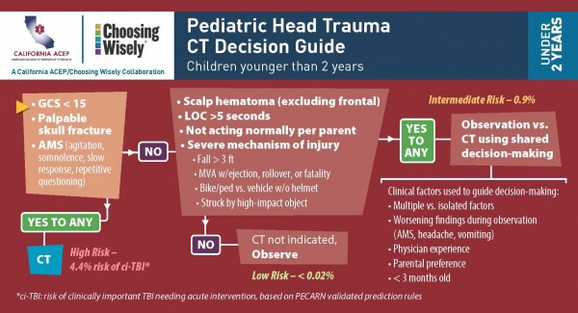
Adult
Guidelines for Head Trauma CT
Infant <2 years
Pediatric

Slide 16
Delayed Imaging Criteria
May see new deficits in weeks or months following injury
Focal neurological findings or mental status change
People who have bleeding risks
People who have difficult neurological exam at baseline
Headache is less reliable reason

Slide 17
Medical Problems Post Brain Injury
*Migraines – Headaches
Sleep – *insomnia and hypersomnia
Balance - Dizziness
Vision –double, blurry, field cut
Hearing - Tinnitus
Smell-Taste
Pain
Nausea
Movement – Paralysis, numbness, tingling
Fatigue
Seizures
Toileting
Shunts
Feeding- Swallowing
Metabolic - Endocrine
* = most common

Slide 18
Cognitive & Communication Issues Post Brain Injury
Executive Functioning
Tires quickly
Can’t seem to wake up
Slow to do things
Short attention span
Poor immediate memory
Poor long-term memory of past events
Difficulty learning new things and remembering recent events
Difficulty clearly stating what thinking
Poor planning
Can’t get started on or finish tasks
Poor organization
Blurts things out at the wrong time
Poor awareness of problems and solutions
Misreads social cues
Slow to read and remember what was read
Slow to do simple addition or can’t do it

Slide 19
Screen and Support for Cognitive Issues
Stamina, Attention, Processing Speed, Working Memory
1. Ask if any of these are different and impaired. PCSS screens for this.
2. Ask if they can repeat back what was said after about 5 to 10 minutes of conversation
3. See if they fatigue quickly or became distracted during discussion
4. Slow down delivery of information, provide time to reflect on what was said
5. Talk in simple phrases and short sentences
6. Write down information
Memory, Organizing, Planning and Doing
1. Ask if any of these are different or impaired, PCSS screens for memory
2. Ask what they remember after 15 minutes or at the end of the session.
3. Ask how they Plan on accomplishing the tasks discussed, how successful they have been in the past, and if they would like some assistance.
4. Write down information for memory
5. Write out step by step instructions for planning
6. Consider follow up calls and getting others involved for Doing tasks
PCSS = Post-concussion symptom scale, including Acute Concussion Evaluation (ACE) and SCAT5

Slide 20
Psychosocial Issues Post Brain Injury
Depression – most common
Anxiety
PTSD
Suicide – 2 to 4 times higher risk (Substance Abuse Treatment Advisory 2010).
Anger – Aggression
Substance Use
Isolation – loss of family & friends
Struggle with coming to terms with changes and recreating identity. Personality changes
Loss of independence
Loss of job and housing and no food or transportation
No insurance or inadequate medical or behavioral care
Worsening of any behavioral health issues prior to brain injury
Duration of changes can be fleeting to lasting a lifetime,
Repetitive brain injuries worsen outcome

Slide 21
Major Overlap of BI Symptoms and Other Issues*
 | Brain Injury | Acute Stress/ PTSD | Anxiety | Depression | Substance Use
Anxious around others | X | X | X | X | X
Hopelessness | X | X | X | X | X
Irritability | X | X | X | X | X
Medical problems | X | X | X | X | X
Loss of friends | X | X | X | X | X
Loss of job | X | X | X | X | X
Poor attention | X | X | X | X | X
Poor memory | X | X | X | X | X
Sleep issues | X | X | X | X | X
Sadness | X | X | X | X | X
Suicidality | X | X | X | X | X
*If there’s a brain injury then make sure to include it in treatment plan along with other issues

Slide 22
Intoxication & Brain Injury
Intoxication is a common factor in many incidents of brain injuries.
Brain injury behaviors can be easily mistaken for intoxication.
Important to treat intoxication AND brain injury if both present.
Some medications can be abused or seen as being abused, such as stimulants.
Some interactions between medications can be confused with intoxication.
Substance use can co-occur with a brain injury.
Illegal substances, marijuana, and alcohol make brain injuries worse.
Refer to treatment for both substance use and brain injury. Have them call BIANM for list of providers who treat both.
Better to get treatment for possible brain injury, then to miss brain injury and have tragic outcome. Further evaluation buys time to clarify severity of brain injury and improve outcome.

Slide 23
Treating Depression, Substance Use & Brain Injury Together
Depression frequently occurs and substance use sometimes occurs with brain injury. Some of the time they all occur together.
Adaptation of traditional therapies for depression, suicide, anxiety, substance use, and other behavioral health issues is required to successfully manage the cognitive sequelae of brain injury.
Treatment of brain injury with co-occurring issues can take a long time with setbacks along the way.
It is important to find appropriate treatment for brain injury with co-occurring issues and provide hope and support through the course of treatment.
The Brain Injury Alliance of New Mexico (BIANM) can help you find appropriate treatment for brain injury with occurring issues.

Slide 24
Pedrotty, M. et al, 2021

Slide 25
Screens for Psychiatric Issues (see appendix)
Depression & Suicide
PHQ9
ASQ
Columbia Suicide Severity Rating Scale
A.C.E.
Anxiety GAD7
Substance Use
AUDIT (cut off score of 11),
DAST (cut off score of 6), &
TICS
PTSD Checklist 5 (PCL 5)

Slide 26
https://cssrs.columbia.edu/wp-content/uploads/Community-Card-Patients-2020-1.pdf

Slide 27
Two Screens for Brain Injury
H.E.L.P. S. At National Association of State Head Injury (NASHIA.org)
OSU-TBI – ID at Ohio State University Brain Injury Prevention and Rehabilitation
5 questions to ask in interview that includes hit on head, hospitalization, loss of consciousness, behavioral changes, and medical illnesses
Easy to score
Can determine if referral is needed from results
Educates on brain injury
https://www.nashia.org/resources-list/cdxvc5lcq3q3ycesazm0wfyg9umxye?rq=helps
https://www.mass.gov/doc/helps-brain-injury-screening-tool-with-instructions/download
Interview or questionnaire
5 questions to ask with follow up and one question about repeated head injuries
3 step process
Provides information on worst, first, multiple, recent and other sources of brain injury
Training video available for free
https://wexnermedical.osu.edu/neurological-institute/departments-and-centers/research-centers/ohio-valley-center-for-brain-injury-prevention-and-rehabilitation/osu-tbi-id

Slide 28
Training is available from the BIANM on how to screen and make a referral for care of brain injury using the HELPS and other screens.

Slide 29
A.C.E. History and Evaluation (see appendix)

Slide 30
A.C.E. Concussion Symptoms Check List
https://www.cdc.gov/headsup/pdfs/providers/ace_v2-a.pdf

Slide 31
A.C.E. Risk Factors Red flags, DX & Plan

Slide 32
4 Steps To Recover from Concussion: Return to Routine (CDC)
Relative Rest, no exercise first few days, nap as needed, monitor symptoms
Moderate Activity and exercise, few days, monitor symptoms
Full Return to Activity and exercise, symptoms gone
Mild Activity and exercise, few days, monitor symptoms
4
3
2
1
Several days of relative (not bed rest) rest up to 1-2 weeks max
Education that symptoms will resolve,
Physical therapy including cervical and vestibular therapy
Progressive, subthreshold (i.e., stopping before significant symptom exacerbation) aerobic exercise

Slide 33
Persistent Post-Concussion Symptoms
Get help IMMEDIATELY if symptoms worsen over first 48 hours.
Initial 6 hour observation period for worsening of symptoms
Continue observation for 24-48 hours for any worsening
If NO symptom reduction after 5 days, or symptoms worsen, then refer to or consult with specialist
Up to 10 to 14 days is typical recovery time from concussion
Multiple or repeated concussions increase risk of longer recovery
Seek further care if symptoms improve but continue after two weeks
Post-Concussion Syndrome can occur if symptoms persist for more than 30 days, about 40% of people with concussion experience symptoms up to a year after the injury
Treatments are effective: Vestibular Ocular Motor (VOM), Vision, Sleep, Headaches, Psychotherapy etc.
Education on concussion helps people realize they are not going crazy and get much needed help.
Notes:
If

Slide 34
Post-Traumatic Headache (PTH)
Most common physical complaint in TBI
Present in mTBI/concussion and severe
IHS classification has shortcomings
There is no one type of PTH
Limited repertoire of headache responses, regardless of nociceptor
Treatment should be multi-faceted

Slide 35
Epidemiology of PTH: Civilian
30 – 90%
Most show improvement in first 3-6 months
40-50% moderate – severe in TBI Model Systems complain of PTH at 12 months
Dominant phenotype now appears to be “migraine”
Risk Factors:
Women
Premorbid Hx HA

Slide 36
Sources of Head Pain
Dura and Venous Sinuses
Skin, nerves, muscles, periosteum and cranial cavities of head and neck
Cervical joints
Cervical musculature
your brain can’t hurt!

Slide 37
Nociceptive Pathways
Tissue injury or inflammation
Bradykinin, serotonin, substance P, CGRP …
DRG in C₁₋₃
Nucleus Caudalis of V
Second order project to VPL
Third order to cortex
“Paleospinothalamic”
Bilateral
Projects to limbic system
Synapses in reticular formation, DM and intralaminar nuclei of thalamus

Slide 38
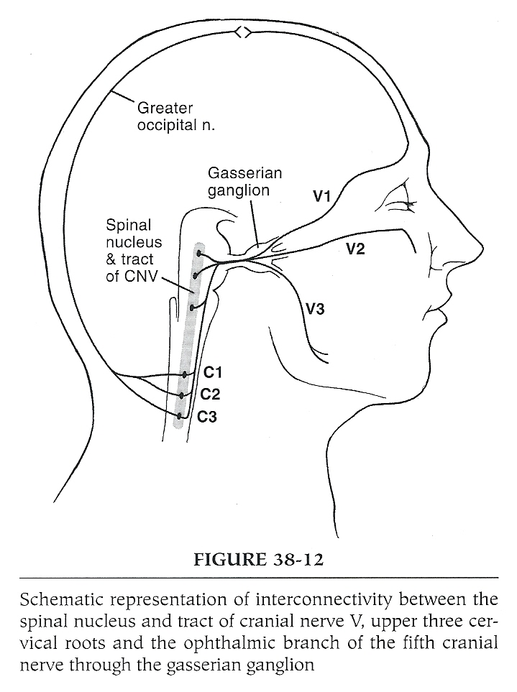

Slide 39
Clinical Evaluation of PTH - C.O.L.D.E.R.
Character: Dull, throbbing, sharp…
Onset: Precipitants, menses, time of day, time post injury
Location: Unilateral, bilateral, occipital, at a scar
Duration and Frequency
Exacerbation: physical activity, touch, sleep, noise
Relief: Medications (how much/often), rest

Slide 40
Clinical Classification System PTH
Post-traumatic Migraine/ Probable Migraine
Musculoskeletal PTH
Tension-Type
Myofascial
Cervicogenic PTH
Craniomandibular PTH
Medication Overuse Headache
Neuralgias/Neuritic
Certain cranial neuralgias
PTH from intracranial pressure abnormalities
High intracranial pressure including tension pneumocephalus
Low intracranial pressure
Syndrome of the Trephined including post-craniectomy headache
Dysautonomic Headaches
Blast Injury Headaches

Slide 41
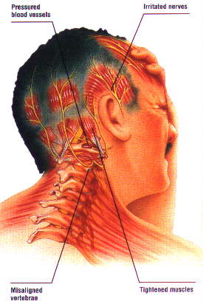
“Musculoskeletal” HA
Classic Tension
Myofascial
Cervicogenic
Cranio-mandibular syndrome

Slide 42
Treatment of Tension Type Headache (TTH)
NSAID
Prophylaxis
TCA
Topiramate
Botulinum
Acupuncture
Behavioral strategies
Biofeedback
Correct sleep disturbances

Slide 43
Migraine Clinical Presentation
Episodic attacks of headaches
Throbbing (lasts 4-72 hours)
Unilateral (but up to 40% become bilateral)
Worse with coughing, bending, physical exertion
Photophobia, phonophobia
Associated autonomic disturbances
Nausea, vomiting, anorexia
With or Without an Aura
Usually visual

Slide 44
Post Traumatic Migraine (PTM) Treatment: Prophylaxis
TCA’s
5HT (blocks reuptake) and block 5HT2 receptors
May lower Sz threshold
Topiramate
Inhibits neuronal firing in trigemino-cervical complex
Cognitive side effects
Valproic Acid
NSAID’s
$β$-blockers
Ca⁺⁺ channel blockers
Botulinum Toxin for Chronic

Slide 45
Newer Rx: Target CGRP
Ubrogepant: CGRPR antagonist
Oral, Abortive
CYP3A4 inhibitors contraindicated
Nausea, somnolence
Rimegepant: CGRPR antagonist
Oral, abortive
CYP3A4 inhibitors contraindicated
Nausea, somnolence
Khloe’ Kardashian likes it
Erenumab: CGRP receptor antag
SQ for prophylaxix
Cramps, constipation, HTN
Eptinezumab: IgG1 antibody binds to CGRP ligand so it can’t bind to receptor
IV every 3 months for prophylaxis
Runny nose, hypersensitivity

Slide 46
Other PTM Treatments
Sphenopalatine block – nerve block
Used in past for cluster HA
Parasympathetic to face and meninges
Therapy to musculoskeletal component
Trigger points
Heat, stretch, massage, strengthening
Naturopathic
Butterbar
Feverfew

Slide 47
Sleep Disorders
An estimated 30%–70% of post–traumatic brain injury (TBI) patients report difficulty sleeping in the first few weeks postinjury.
Hypersomnia is likely to be present in 25% of TBI patients within the first few days after injury
Following the acute phase of injury, insomnia symptoms are reported in 30% of people³ and circadian rhythm shifts can also present in approximately 36% of those in the post acute phase.
Overlap with psychological problems: PTSD, depression
Check for sleep apnea, including central and OSA, with a sleep study
Treatment involves “sleep hygiene,” behavioral interventions, and medication

Slide 48
Sleep Disorders, Fatigue & TBI
TBI
Sleep
Fatigue
Dep
Anxiety
Pain
Sleep disturbance and fatigue are persistent and common sequela of TBI
Fatigue may cause depression and anxiety
Impaired cognitive functioning may create fatigue which in turn requires greater cognitive effort and can result in pain. (Ponsford and Sinclair, 2014)

Slide 49
Most Common Sleep Disorders in TBI Overall
Insomnia: 50%
Poor sleep maintenance and sleep efficiency (49–50%)
shorter total sleep duration and greater wake after sleep onset time
Decreased time in REM
delayed sleep onset (36%),
early morning awakenings (38%),
nightmares (27%)

Slide 50
Non-Pharmacologic Management of Sleep Disorders
Sleep Hygiene:
Sleep homeostatic factors (exercise)
Circadian factors
Medication/drug effects
Arousal in sleep setting
Behavioral Strategies (CBT)
Light Therapy: blue light (during day) increases wakefulness
OMT
Acupuncture
Mindfulness meditation
Diet:
Branched chain amino acids – Orexin
Tryptophan and carbohydrates – serotonin
Possibly Melatonin
Herbs: Valerian and others
Marijuana

Slide 51
Pharmacologic Management of Sleep Disorders
Low dose Trazodone
Prazosin: if nightmares and PTSD
Mirtazapine
TCA’s, reasonable in concussion but not first line, avoid with more severe brain injuries because of anticholinergic effects on cognition, etc.
Doxepin
Amitriptyline
Avoid Benzodiazepines
Non-benzo Zopiclone and Exzopiclone short term
Neurostimulants as needed to promote daytime arousal, such as Modafinil

Slide 52
Dizziness/Dysequilibrium
May be central or due to “concussion” to labarynthian systems
Reported to occur in 23% to 81% of cases in the first days after injury
Estimates of the prevalence of persistent dizziness after mild TBI vary widely from 1.2% at 6 months to 32.5% at 5 years.^{5–}
Usually dissipates in 3 months
Vestibular therapy shortens time to resolution
Persistent complaints warrant treatment
Medication
Physical therapy techniques
Rarely surgery

Slide 53
Evaluation of Post-Concussive Dizziness with Focal Neurologic Deficits
Neuro-otology consult
Imaging
Electronystagmography (ENG)
Caloric/rotary testing
Posturography

Slide 54
Treatment of Post-concussive Dizziness
Physical Therapy
Habituation Exercises
“Liberatory” Exercises (BPPV)
Oculo-vestibular Exercises
Behavioral
Pharmacological

Slide 55
Pharmacological Treatment of Post-Concussive Dizziness
Meclizine (Antivert)
Antihistamines
Loratadine
Secondary options that have significant side effects and can delay recovery from concussion and dizziness
Scopolamine (anticholinergics)
Benzodiazepines
All may impede “natural” recovery and/or effectiveness of therapy

Slide 56
Summary
Many somatic symptoms resolve within 6 months of brain injury
Headache, Sleep disorders and fatigue, dysequilibrium
It is important to clarify type of headache to determine the initial intervention, but given overlap in central nocioception, treatment may require a multi-faceted approach ( i.e., migraine treatment may include management of musculoskeletal/tension headache)
There are several interventions for dizziness
It is important to clarify type of sleep problems to determine best intervention

Slide 57
Medications for Behavioral Health Issues
Evaluate interactions of medications and potential side effects
Minimize, as much as possible, the use of medications,
Discontinue any medications that could be contributing to reduced cognition, confusion, etc. as appropriate (Beers criteria for medication)
Prescribe medicine and psychotherapy together to maximize outcome
Start low and go slow, assess risk for overdose and need for support to take medicine
For aggression assess if it is due to top down or bottom-up issues to select medications
Refer to psychiatrist, neuropsychiatrist (Dr. D. Quinn), physiatrist (Dr. W. Austin Davis), Call UNM PALS (505-272-2000) for consultation.

Slide 58
It is imperative to code brain injury so that the person is eligible to receive appropriate services.
See appendix for more information.

Slide 59
What is Domestic Violence (DV), or Intimate Partner Violence (IPV)?
It is one of the most common forms of violence against people, the most violent against women, and includes:
Physical, sexual, financial,emotional abuse, controlling behaviors by person they are having an intimate relationship with.
Strangulation is an extreme source of control, instills a fear for their life, increases risk of murder within the year by 750%
Victims who are strangled are 7.5 times more likely to die in the next year.

Slide 60
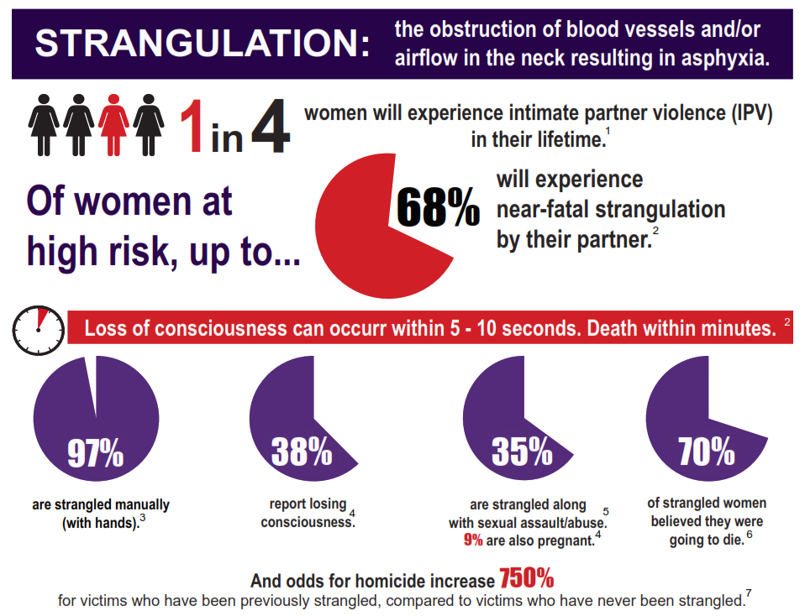
Notes:
WHO puts out this card? Has it been updated?

Slide 61
Strangulation Basics
Screen for brain injury, including strangulation, if suspect DV, especially if mental health and addictions are present.
Many ways to be strangled
Requires applied force that includes location, surface area, pressure, and duration
Only 11 pounds of pressure on both carotids for 7 seconds is necessary to cause unconsciousness
May have some tonic-clonic (jerky-twitchy) movements
If pressure released immediately consciousness will be regained within 10 seconds
Usually has some loss of memory
About 15 seconds of unconsciousness may be incontinent
About 30 seconds of unconsciousness may be encopretic
About 50 seconds of unconsciousness bounce-back reflexes inoperative – will need CPR
May have lasting brain injury
Increases risk of stroke by 2% due to potential injury to arteries and veins, seeking medical care can assess for this.
Half the time signs of strangulation are not evident.
Important to believe the victim.

Slide 62
Know the SIGNS
Bleeding from mouth
Fainting and/or LOC
Redness on neck
Injuries to shoulders
Abrasions (chin, neck, shoulders)
Vomit (aspiration)
Raspy breathing
Petechiae
Bruising
Impression marks
Fingernail cuts
Ligature marks/burns
Neck/Tongue swelling
Injuries to back of head
*Soiled clothing (urine ~15”/feces~30”)
Vital FACTS for Victims of STRANGULATION strangulationtraininginstitute.com
Some injuries can be from perpetrator or victim fighting for their life
Notes:
T

Slide 63
Know the Symptoms Subjective Information given by Victim
Voice changes
Hoarseness
Difficulty swallowing
Breathing changes
Sore throat
Headaches
Seeing stars
“Going black”
Tunnel vision
Change in mental status
Loss of Memory
Rule: If suspect DV with mental health and addiction issues then screen for brain injury, including strangulation.

Slide 64
Medical Tests for a Recent Assault Strangulation
Include the need to consider a CT-A if strangulation included arteries and veins, could have resulted in dissection:
CT-Angio of carotid/vertebral arteries (GOLD STANDARD for evaluation of vessels and bony/cartilaginous structures, less sensitive for soft tissue trauma) or
CT neck with contrast (less sensitive than CT Angio for vessels, good for bony/cartilaginous structures) or
MRA of neck (less sensitive than CT Angio for vessels, best for soft tissue trauma) or
MRI of neck (less sensitive than CT Angio for vessels and bony/cartilaginous structures, best study for soft tissue trauma) or
MRI/MRA of brain (most sensitive for anoxic brain injury, stroke symptoms and inter-cerebral petechial hemorrhage)
Evaluation for Concussion

Slide 65
STRANGULATION Assessment Card strangulationtraininginstitute.com

Slide 66
Screen, Brief Intervention, Refer for Treatment (SBIRT): Strangulation
Assume BI if DV, screen for signs/symptoms, including strangulation, & repeated head injury.
Screen for mental status, post-concussion symptoms, memory, and safety. Reassure on safety.
Transport if have significant injuries, if no transport then educate, accommodate and refer to follow up.
Provide compassionate support through this very difficult and stressful time for the victim.
Note: Strangulation doesn’t show injury more than half the time, believe the person, be supportive a & tell victim of being at 10 times the risk to be murdered within the year by offender.
Note: Remember brain injury, intoxication, and trauma have much overlap. Include brain injury as part of treatment if it is present and co-occurs with other similar looking issues.
Referral Options:
Medical: ED, Urgent Care, Clinics, SANE. Determine who is the best medical provider in your area for DV.
Community services: BIANM, BIAC, NMBIRC, NMCADV, CVRC, law enforcement, restraining orders, help with rent and relocation, case management, & red flag law
Repeated head injuries – educate on worse outcome and need to prevent further head injury
Repeated follow-up – assess for current status, compare to past status, make accommodations as needed, continue to support and refer to services, & provide hope
Remember it can take many abusive events for a partner to decide to leave the offender. Education, patience, compassion, hope, and support are essential over the long term.

Slide 67
Cognition Basics
At time of injury cognition can be impaired with confusion, slow response times, forgetfulness, irritability, poor decision making and planning, impulsivity, slurred speech, fatigue, sensitivity to loud noises and lights, falling down, argumentativeness, noncompliance, anger, and headaches. It is easy to confuse this for intoxication.
Both brain injury and intoxication can occur at the same time.
Cognitive impairment can continue past the initial injury and require appropriate accommodations and long-term care.
It is important to identify that a person has had a brain injury or been strangled, once or more, what accommodations are needed, and what services and support are needed.
People living with brain injury do NOT want to be treated as if they are intellectually impaired or have a developmental disability.
Education about brain injury is helpful. However, it is important to not be confrontative or forceful in educating someone on the possible or actual brain injury they have.
Treatment for cognitive issues can take years and requires much patience, support, compassion, and community coordination of care.
Emotional, substance use, and medical issues can interfere with recovery and need to be included in treatment of cognitive issues and vice versa.

Slide 68
Assess, Accommodate, & Act: No Awareness & No Insight
Assess: Awareness of having a brain injury and insight into how to manage the brain injury is essential in assessing what accommodations and support are needed.
No to Low awareness means there is no to low insight and requires broad accommodations and maximum support. The person either is not aware or is barely aware that they have a brain injury. They have no thoughts on how to manage their brain injury. Education on brain injury can be helpful. Do not be forceful in educating person. The person may be overwhelmed. Screen for mood and thoughts of self-harm.
A severe brain injury can result in no awareness of their actions and requires much support and patience. This is called anosognosia.
Accommodate: Broad accommodations include being calm, compassionate & patient, slowing down the interaction, providing more time to do things & respond to questions, repeating information calmly as needed, checking for understanding, help with planning steps to do things & setting reminders as needed, taking breaks when tired, encouraging, & writing down important information.
Act includes providing accommodations and resources to contact, educating on possibility of having a brain injury, and checking with caregivers on safety and support.
For safety, if there are guns in the home then locking up or removing the guns is essential.
For prevention, it is important to educate on ways to avoid getting another brain injury, including fall prevention and getting appropriate support in the home. In IPV with strangulation it is important to educate that the risk is 7.5 times greater to be murdered within the year by their partner, than those who are not strangled. If depressed and having thoughts of self-harm then provide national suicide prevention lifeline number (988), discuss safety plan, and check if immediate care is needed.

Slide 69
Assess, Accommodate, & Act: Good Awareness & Insight
Assess: Good awareness is very helpful and provides opportunity for good insight into how best to accommodate the brain injury. Asking what the person needs help with (accommodations) on any thinking issues related to the brain injury is important.
If they have limited insight, then it is helpful to add in whatever broad accommodations might be helpful. If they have good insight, then what they tell you is needed will most likely be sufficient. Screen for mood and thoughts of self-harm.
Accommodations: Broad accommodations are the same as for no awareness. Specific accommodations include things the person requests. Broad accommodations include being calm, compassionate, & patient, slowing down the interaction, providing more time to do things and respond to questions, repeating information calmly as needed, checking for understanding, help with planning steps to do things & setting reminders as needed, taking breaks when tired, encouraging, and writing down important information.
Act includes providing accommodations and resources to contact, reviewing care and safety plan, and checking with caregivers as needed on safety and support.
For safety, if there are guns in the home that are not secured, then locking up or removing the guns is essential.
For prevention, it is important to educate on ways to avoid getting another brain injury, including fall prevention and getting appropriate support in the home. In IPV with strangulation it is important to educate that the risk is 10 times greater to be murdered within the year by their partner, than those who are not strangled. If depressed and having thoughts of self-harm then provide national lifeline number (988), discuss safety plan, and check if immediate care is needed.

Slide 70
How to Provide Support and Accommodations
Ask if they have had a brain injury. If no or don’t want to answer, then go to Probe. If yes, then ask what they are aware of, any insights into what works, and how they would like assistance from you, if any. If low awareness and insight, then explore with them possible accommodations that might help.
Ask
Probe
Ask
Provide
Provide
Ask
No
Yes
Explore thinking skills, awareness, and possible injury
Provide support requested or agreed upon that is reasonable and appropriate.
Ask if any support might be helpful.
Ask if the support provided is helpful and what, if any, other support might be helpful.
Note: Consider what stage of recovery the person is in and what are appropriate expectations for that stage.
Provide support requested or basic support as appropriate

Slide 71
Accommodations Over Time for Cognitive Issues
Accommodations for cognitive issues can change over time as new ways to manage cognitive issues are learned and the person heals or worsens.
Accommodations may include the use of external and internal compensatory strategies such as the use of smart phones and reminders to oneself to do specific things, adaptation of living and workspace, support by care-givers, and medication.
Generalizing new skills to every day living situations is very important in treatment and requires much patience, support, and compassion.
Developing a healthy and safe lifestyle to improve healing and prevent another brain injury is very important.
Asking the person living with a brain injury what skills & accommodations they use and are working on and how you can be of help is important over the long-term of treatment. Asking helps to break this silent epidemic!

Slide 72
Right Dose at Right Time – Moving Target
Brain Injuries are unique, and recovery is dynamic over time
Recovery can include initial denial and shock with little awareness and insight and gradually over time increase ability to advocate appropriately for what is needed.
Recovery is not always linear or always getting better, but rather might have some setbacks along the way that require changes in accommodations.
Getting appropriate long-term care is essential to good outcome.

Slide 73
Stages and Tasks in Recovery of Cognitive Issues from Brain Injury
Surviving
Awareness
Low Insight
Healing
Insight developing
Focus on learning external and internal strategies
Thriving
High Insight & Awareness
Focus on Generalizing skills to environment
Environmental support
External strategies
Intensive therapies
Crisis mode
Less intensive therapies
Intermittent crises
Environmental support
Fewer therapy sessions
Minimal environmental support
Engaged in community
Mood good
Few to no crises
Good self-advocacy skills
Process can take months to years with setbacks, pauses, plateaus and crises along the way

Slide 74
Adjusting Accommodations
Environmental support
Private and public spaces
Person support –
include ADA rules and guidelines
Goal is to move from maximum to minimum support as recover.
External compensation
Notebooks, video and auditory recordings, written notes, calendar, alarms, etc.
Include ADA rules and guidelines
Internal compensation
Metacognitive strategies
Medications
Healthy lifestyle – Sleep hygiene, diet, exercise, hobbies, mindfulness
Medical - Headaches, pain, vision, etc.
Complementary & Alternative Medicine
Progress or setbacks in relearning or learning skills and stability in life can require adjusting accommodations

Slide 75
Addressing Cultural Issues When Creating Supportive Interventions and Accommodations
Use open ended questions
Monitor unconscious bias
5Rs of Cultural Humility: Reflection, respect, regard, relevance, and resiliency (Masters et al., 2019)
Develop own self-awareness
Take person where they are at
Clarify what resources they have and prefer and any barriers to obtaining or using resources
Be client-centered, realistic and supportive

Slide 76
Accommodations for Cognitive & Other Issues
 | Adapt Living Space | Caregive Support | External Supports | Internal Reminders | Healthy & Safe Living | Medication
Executive Functioning
Fluency
Communication
Memory
Working Memory
Attention
Processing Speed
Alertness Stamina
Headaches
Sleep
Dizziness
Mood – Self harm
Substance use

Slide 77
Support Plan
Support for___________ | Staff, Care-giver and Person living with brain injury
Adapt Living Space
Staff Support
External Support
Self Reminders
Healthy & Safe Living
Medication

Slide 78
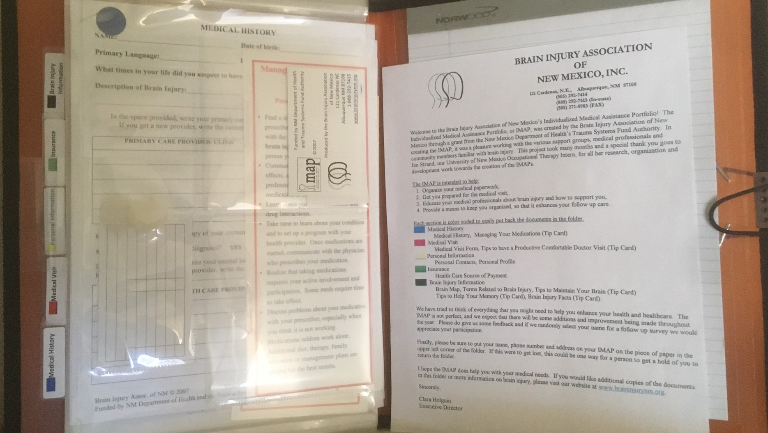
Organizational and Planning Support
Smart phone
File folder – written material
Follow up calls
Transportation
Medication – purchase, taking, long-distance monitoring, etc.
Independent living skills
Brain Injury Buddy

Slide 79
Peer Support Groups
Peer support is excellent for people living with brain injury and their care givers.
T.H.R.I.V.E. with BI Support Group BIANM (info@braininjurynm.org )
“How to” manual on running the T.H.R.I.V.E support group for both the facilitators and the group members
Allows for focused discussion on BI-relevant topics; individual assessment on where a person is in their recovery – surviving, healing, or thriving; and assessment of thinking skills and suggestions on how to improve on them

Slide 80
Best Practice Guidelines for Health Care Provider
Screen for DV, BI, mood, SU and other?
Treat/Support for DV, BI, Mood, SU, medical, financial, housing, transportation, case coordination, safety, other
Refer – warm hand off when possible, safety protocol in place for DV survivors, referral note to give to patient that can be delivered to other resource, consent to fax referral information, schedule follow up appointment while in office, provide iMAPS if appropriate and available,
Inpatient or ER
Medical emergency: what?
Psychiatric emergency: threat to hurt self, other, or psychotic
Detox
Urgent Care
Medical issues: What?
Outpatient
medical:
Rehabilitation: PT, SL, OT, other
Pain
Headaches
Vision
Other
behavioral health: List of Mood issues
cognitive: List of cognitive issues
SU
Vocational Rehab DVR
Other
DV or community agency
Employment/Housing/Legal
Federal/State Assistance
BIANM/NMBIRC/BIAC/BISF – Support groups, information, advocacy
Follow up: care coordination by Whom?
Repeat process, providing support and making referrals as needed.

Slide 81
Making Referrals
It takes a team to help people heal from brain injury.
Developing a list of agencies and healthcare professionals who can help is important. Joining the DVBI Care Network can help develop your list.
Encouraging a person living with a brain injury to get help is the first step if they have yet to do so. Providing information to call or email the NMBIAC, BIANM, NMBIRC or any other useful organization to get started is helpful. If they have been unsuccessful in getting care then encourage to call the NMBIAC and BIANM (again if they have called them in the past). For DV the National Domestic Violence Hotline at 1-800-799-7233 or Text START to 88788 can help connect them to appropriate resources.
When sharing information on what is a brain injury and how best to get good care and support remember it may take a few discussions before the person connects to care. Provide hope and compassion.

Slide 82
Referrals – Who Can You Refer To?
Psychologist/counselor
Neuropsychologist
Psychiatrist
Sleep specialist
Vision specialist
Neurologist
Physiatrist – brain injury medicine / PM&R
Occupational Therapist
Physical Therapist
Speech Language Pathologist
Other

Slide 83
Resources – Know Your Team
Rehab TX
CTH UNMH
Counseling
BIANM
BIAC
Neuropsychology
Vision
Other
Invision Dr. M. Cohen DO
Physiatry
W. Austin Davin, MD Lovelace - UNMH
Psychiatry
Pres
Hosp
UNMH
Davin Quinn, MD UNMH
NMBIRC
NMCADV/SANE
Neurology
UNM-HSC Carrie Tingley Hospital Pediatric Concussion Clinic (PCC) Dr. A. Okamura
(505) 272-7464 Ages 2 to 20 years
Interdisciplinary Team: Pediatrician, PT,
Provides recommendations and follow up as needed.
Access to pediatric psychiatry and other specialties as needed
UNM HSC Carrie Tingley Hospital Pediatric Rehabilitation
Lovelace – UNMH Dr. W. Austin Davis, MD
Invision – Dr. Michele Cohen, DO
Free Consultation UNMH PALS line 505 272-2000
Other : NMBIAC, BIANM, NMBIRC, NMBISF, NMCADV, SANE, ARCA Neurorehab

Slide 84
Resources for Support and Care
You are an excellent resource by providing education, support, compassion, and hope.
Other resources include hospitals, healthcare providers, first responders, and agencies to provide support for shelter, protection, transportation, navigation of the system, finances, and daily living.
A list of agencies is provided to give to the person living with brain injury to help get them the support and care they need and to break this silent epidemic.
The NM Brain Injury Advisory Council of the Governor’s Council on Disability (NMBIAC) provides useful information on resources.
The Brain Injury Alliance of New Mexico (BIANM) provides useful information on resources, navigation, support groups, care coordination, life skills coaching, education, advocacy, etc.
The NM Brain Injury Resource Center (NMBIRC) provides useful information on resources, navigation and support groups.
The NM Coalition Against Domestic Violence (NMCADV) provides useful resources related to staying safe, education, and advocacy.
The DVBI Care Network provides education and support to the community of people who serve people living with brain injury and survivors of DV. It takes a community to recovery from brain injury and the DVBI Care Network helps to connect stakeholders in the community.
The National Suicide Prevention Hotline 988 is a national hotline that connects people to local groups to provide support through a crisis.

Slide 85
Hand-out or 2 sided card
Concussions, brain injuries and strangulation can have long lasting effects & require long-term treatment
After a concussion it is important to decide if you need to go to ER & to follow the 4 step return to routine plan.
It is important to stay safe & get support & professional care after a concussion, brain injury, or strangulation.
Victims of domestic violence who have been strangled are at 10 times the risk to be murdered within the year by their abusive partner.
It is common to get a second brain injury after the first one & outcome can be worse after repetitive brain injuries. Avoid getting another brain injury.
It is never too late to get professional care. Recovery can take a long time and require community support.
It is essential to make accommodations to typical medical care to make treatment of brain injury more effective.
It is helpful to tell people how you are managing the effects of your brain injury and how they can help. Self-advocacy is important to you getting the best care.
Resources to contact:
NM Brain Injury Advisory Council – GCD (BIAC) www.nmbiac.com (505) 476-7328
Brain Injury Alliance of New Mexico (BIANM), www.braininjurynm.org (505) 292-7414, 888 292-7415
NM Brain Injury Service Fund for uninsured, www.hsd.state.nm.us/LookingForAssistance/brain-injury.aspx
NM Brain Injury Resource Center (NMBIRC) www.arcaopeningdoors.org/services/new-mexico-brain-injury-resource-center/ 505-243-3835 or 1-844-366-2472
National Suicide Prevention Lifeline 988 www.suicidepreventionlifeline.org
NM Coalition Against Domestic Violence (NMCADV) www.nmcadv.org
National Domestic Violence Hotline at 1-800-799-7233 or Text START to 88788
Center for Disease Control (CDC) concussion information www.CDC.gov/headsup

Slide 86
Building Bridges in the Community to Create a Network of Care
BI DV SU Psy, etc.
Community Agencies
Community Health Care Providers
Communication

Slide 87
Integrative Rehabilitation Model
Biological
Psychological
Cognitive
Social
Spiritual
Medical Health Professionals
Rehabilitation Therapists (PT, OT, SLP)
Psychologists – Counselors -Neuropsychologist
Social Work
Information Technology
Support Agencies
Person Living with Brain Injury
Family
School or Work
Community
BioPsychoCogSocialSpiritual Model

Slide 88
DVBI Care Network –Breaking the Silent Epidemic
We Need You! We are stronger with your help.
DV agencies
BI agencies
Community Support agencies
Crime Victims Assistance Unit
DVR
1st Responders
School/Work
PCP, PA, RN, Neurologist, Psychiatrist, Vision, Physiatrist, Rehabilitation Therapists – Speech, Occupational & Physical Therapies, Neuropsychologist, Psychologist, counselors,
Social workers, IT specialists,
Other
To join, email us at DVBICare@braininjurynm.org or call 505 292 7414
This Photo by Unknown Author is licensed under CC BY-SA

Slide 89
Building Your DVBI Care Network
Identify champions for DV and Brain Injury
Apply Trauma Focus model
Identify screens and how to implement them
Identify resources in the community to collaborate with
Build trust, and resiliency
Select goals and objectives that are important to patient and their family and stage appropriate,
Provide helpful educational and supportive materials that accommodate brain injury
Monitor for safety and support as needed, follow up frequently
Maintain dignity and respect of patient
Join DVBI Care Network, including listserv

Slide 90
Professional Listserv Resource
Join
Join community of professionals with similar interest and wide range of experience and knowledge.
Ask
Ask for help with issues.
Provide
Provide support and suggestions.
Sign up
Sign up by sending request with your email address, agency, location, and specialty to DVBICare@braininjurynm.org

Slide 91
Status of Treatment in NM
Level 1 Trauma - UNMH
Inpatient Acute Care
Limited Inpatient Subacute Care
NO Intensive Outpatient Care
Limited Outpatient Care
NO Supportive Housing (exception of Heading Home)
Need to go out of state for subacute care, intensive outpatient, & step-down services.
The Silent Epidemic
Building services at Lovelace-UNMH and ARCA Neurorehab
People living with brain injury get inappropriate care, have worsening of condition, and iatrogenic symptoms. Traditional interventions need to be accommodated for brain injury.
Professionals who treat people living with brain injury can be very frustrated and feel helpless, hopeless & isolated.
The survivor or patient is blamed for their plight.
Perpetuation of myth that there is no need for or effective treatment of brain injury after two years of recovery.
Perpetuation of myth that concussions are mild brain injuries and don’t require medical care.

Slide 92
Trauma Informed Care
4 R’s
1) Realize the prevalence of traumatic events and the widespread impact of trauma;
2) Recognize the signs and symptoms of trauma;
3) Respond by integrating knowledge about trauma into policies, procedures, and practices; and
4) seek to actively Resist Re-traumatization.
https://www.ahrq.gov/ncepcr/tools/healthier-pregnancy/fact-sheets/trauma.html
Raja, S., Hasnain, M., Hoersch, M., Gove-Yin, S.,Rajagopalan, C. & Kruthoff, M

Slide 93
Summary
Brain injury can happen to anyone at anytime and is very common.
There are multiple causes of brain injury, including falls, MVA, assaults, strangulation, toxicity, infections, and other medical conditions.
Brain injury is a CHRONIC medical condition that requires long-term care and a team of experts.
Brain injury can co-occur with behavioral health issues, including substance use, and can easily be overlooked due to other conditions.
It is important to treat brain injury along with other medical conditions.
Prevention of brain injury and repeat brain injury is important.
It is essential to break the silence of brain injury.
Identifying brain injury and educating people on its treatment is very important in avoiding unnecessary suffering and inappropriate treatment.
Talking about brain injury in domestic violence situations is important and can save lives.
A continuum of care is needed to improve outcome.
Training rural healthcare providers and first responders to identify and treat brain injury is essential to improving care.
Family support is very helpful in recovering from brain injury.
It takes a community to treat brain injury and help families heal. The DVBI Care Network is building community. Please join us!

Slide 94
Resources
NM Brain Injury Advisory Council – GCD www.nmbiac.com (505) 476-7328
Brain Injury Alliance of New Mexico, www.braininjurynm.org (505) 292-7414
DVBI Care Network email at dvbicare@braininjurynm.org
NM Brain Injury Service Fund for uninsured, www.hsd.state.nm.us/LookingForAssistance/brain-injury
NM Brain Injury Resource Center www.arcaopeningdoors.org/services/new-mexico-brain-injury-resource-center/
Center for Disease Control www.cdc.gov/headsup
TBI Model Systems
DVBI ToolKit – go to BIANM website (https://braininjurynm.org ) or call BIANM or the NMCADV
Other
NM Crime Victims Reparation Commission
NM Coalition Against Domestic Violence: (505) 246-9240
Domestic Violence Agencies see appendix for local agency
S.A.N.E.
UNMH – Lovelace Rehabilitation - Physiatrist William Austin Davis, MD clinic (505) 727-3656
UNM-HSC – neuropsychiatrist, Davin Quinn, MD
UNM-HSC-Carrie Tingley Hospital – Pediatric Concussion Clinic, Anthony Okamura, MD; Pediatric TBI clinic, Denise Taylor, MD (505) 272-7464
UNM-HSC PALS line (505) 272-2000, Consultation
Invision – Michelle Cohen, OD, neuro optometric rehabilitation, (505) 341-2020 invisionvt.com
ARCA Neurorehabilitation
Other

Slide 95
Thank you for your attention and participation!
Special thanks to the NM Brain Injury Advisory Council – GCD for supporting this training and vision, and Lawrence J. Horn, MD and Margot Feldvebel, LCSW, BIANM board president for their expertise.
Contact Information:
Mark Pedrotty, PhD Gail Starr, MSCJA, RN NMCADV W. Austin Davis, MD
mpedrotty@braininjurynm.org gail.starr@abqsane.org wadavis@salud.unm.edu
(505) 292-7414 (505) 248-3153 (505) 246-9240 (505) 727-3656
Brain Injury Alliance of New Mexico (BIANM)
info@braininjurynm.org
(505) 292-7414

Slide 96
References
https://www.nichd.nih.gov/health/topics/tbi/conditioninfo/symptoms
https://www.nsvrc.org/sarts/toolkit/5-7 National sexual violence resource center, great resources for healthcare providers, first responders, law enforcement, legal, and paraprofessionals
National Academies of Sciences, Engineering, and Medicine 2019. Evaluation of the Disability Determination Process for Traumatic Brain Injury in Veterans. Washington, DC: The National Academies Press. https://doi.org/10.17226/25317. free online book, 211 pages
https://cssrs.columbia.edu/training/training-options/
https://nida.nih.gov/sites/default/files/audit.pdf
https://arc.psych.wisc.edu/self-report/drug-abuse-screening-test-dast/
https://www.ptsd.va.gov/professional/assessment/adult-sr/ptsd-checklist.asp
https://www.tbh.org/sites/default/files/Generalized_Anxiety_Disorder_Screener_GAD7.pdf
Vital FACTS for Victims of STRANGULATION strangulationtraininginstitute.com
Strangulation Assessment Card strangulationtraininginstitute.com
See appendix for screens and information.

Slide 97
References
Leddy, J. J., Master, C. L., Mannix, R., Wiebe, D. J., Grady, M. F., Meehan, W. P., Storey, E. P., Vernau, B. T., Brown, N. J., & Hunt, D. (2021). Early targeted heart rate aerobic exercise versus placebo stretching for sport-related concussion in adolescents: A randomised controlled trial. The Lancet Child & Adolescent Health, 5(11), 792–799.
Leddy, J. J., Baker, J. G., & Willer, B. (2016). Active Rehabilitation of Concussion and Post-concussion Syndrome. Physical Medicine and Rehabilitation Clinics of North America, 27(2), 437–454. https://doi.org/10.1016/j.pmr.2015.12.003

